Slide 1
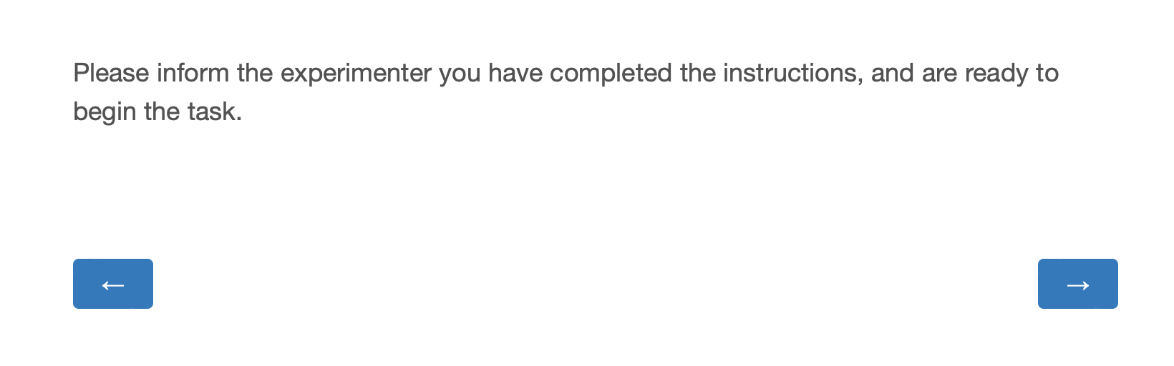
Welcome to the Inspection game! In this game, you will compete against the other participant (Player 2) to earn as many points as possible.
As in previous games, your points will be converted into bonus money for you at the end of the session.

Slide 2
The Inspection game features an Employee and an Employer.
As Player 1, you will be the Employee. Player 2 will be the Employer.

Slide 3
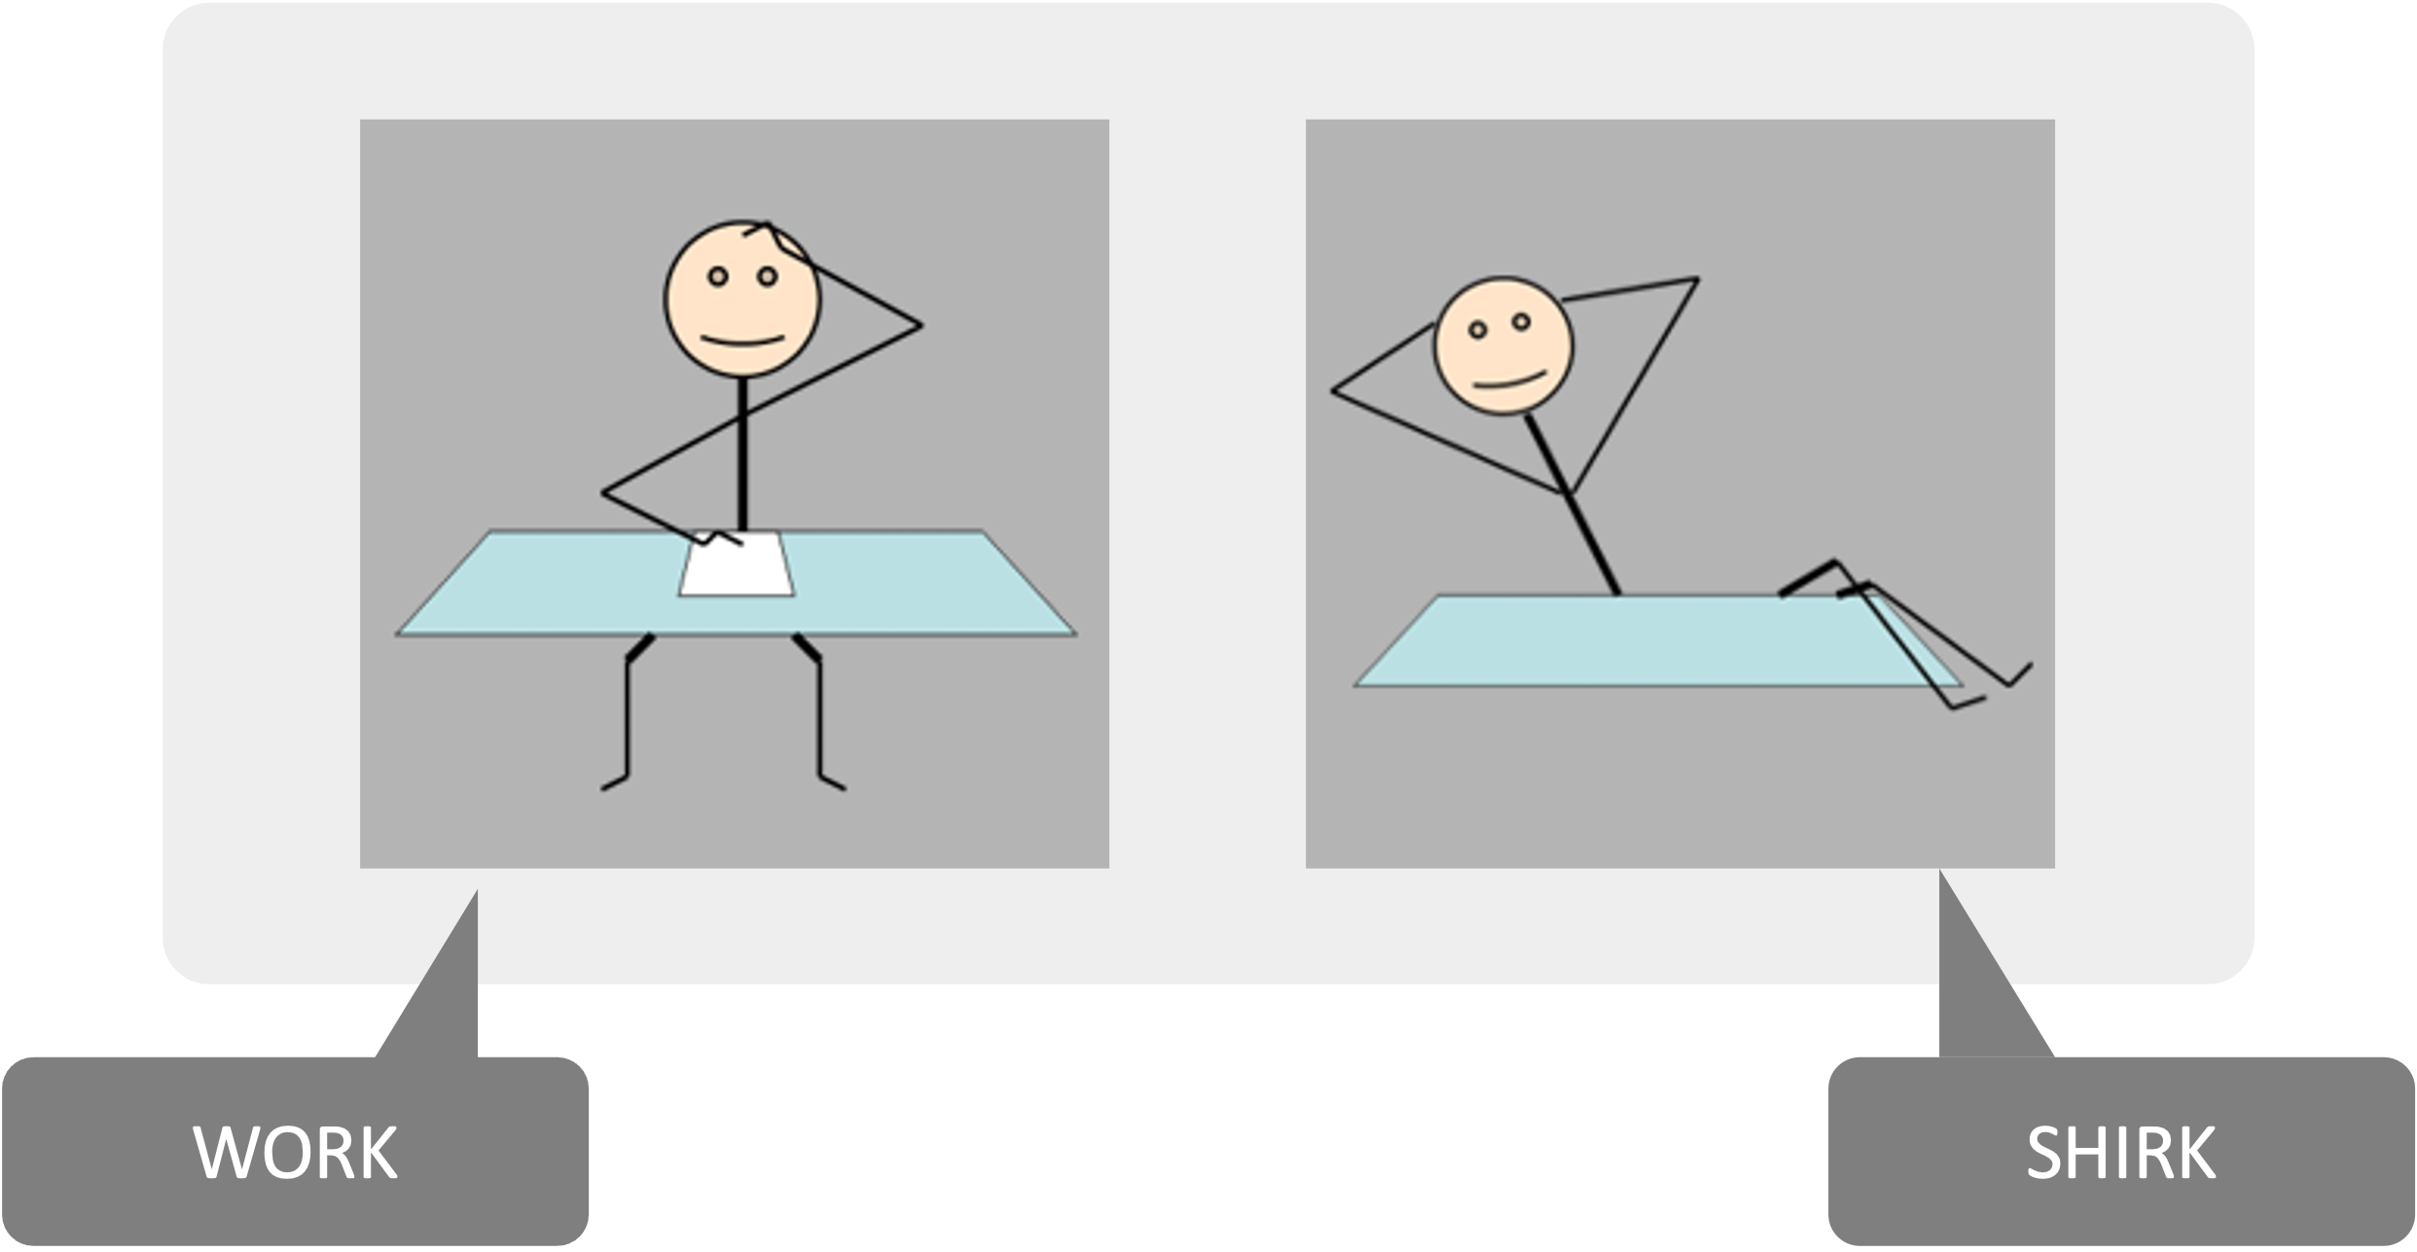
As the Employee, you will choose whether to work or not work ('shirk') on each round.
Notes:
Pat: ”I also winder if in the pictures you want to say ‘You (the employee)’ and ‘the Employer (player 2)’?”

Slide 4
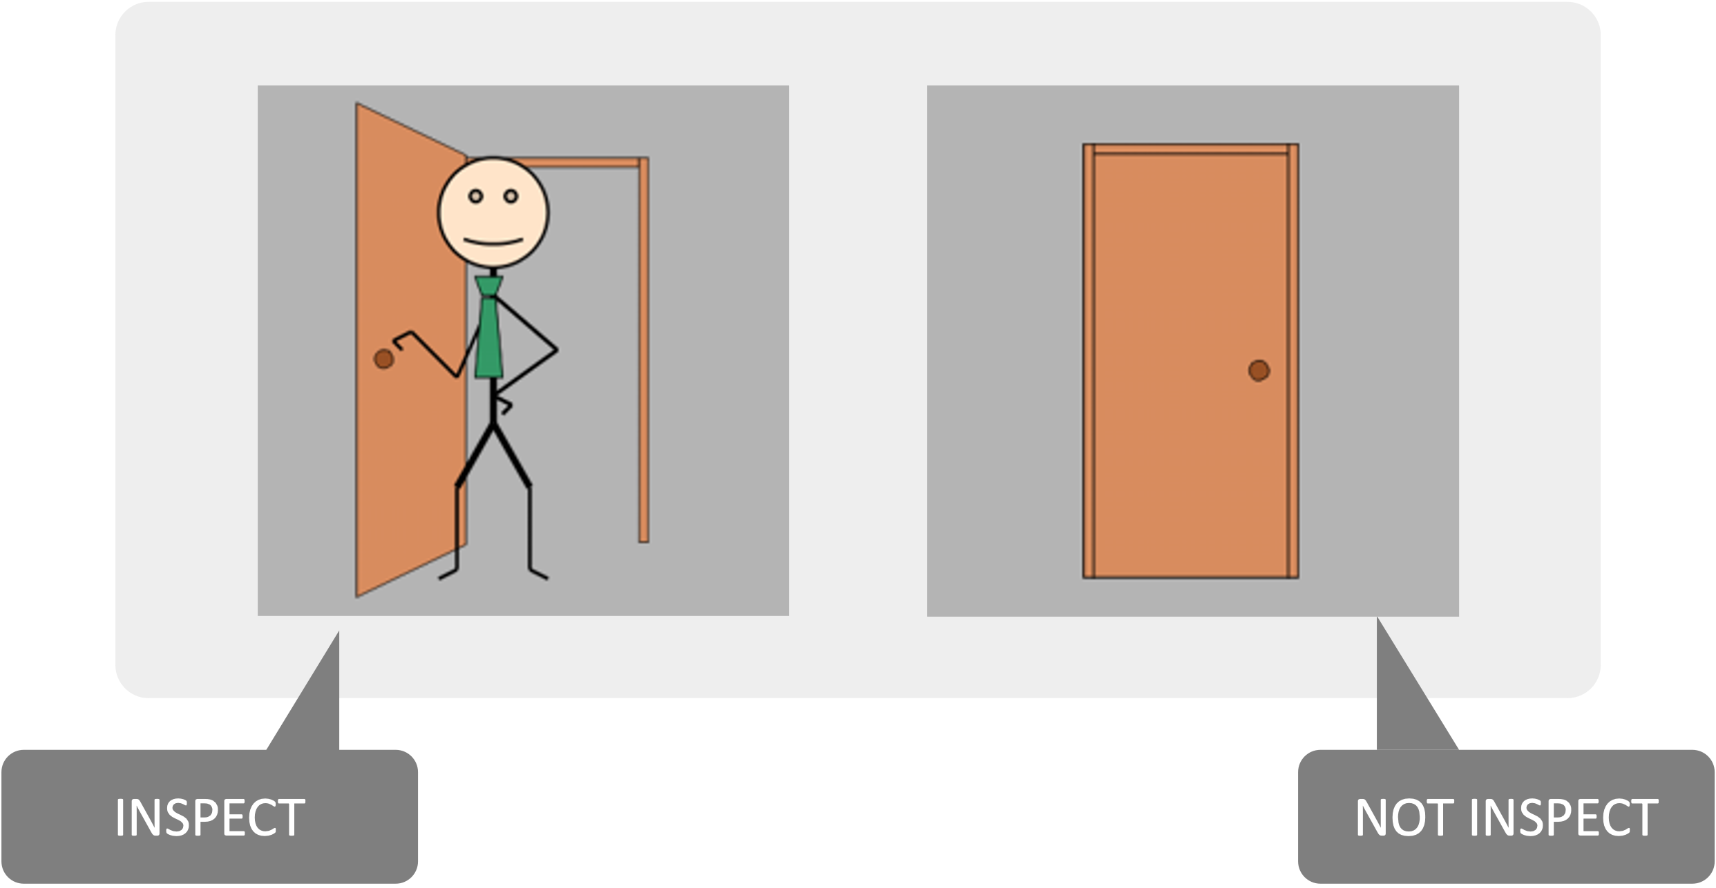
As the Employer, Player 2 will choose either to check in on you ('inspect') or not on each round.

Slide 5
To make your decisions, use the LEFT and RIGHT arrow keys. You will only have 4 seconds to choose, so be quick!

Slide 6
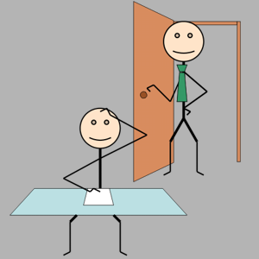
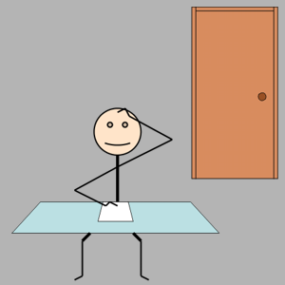
If you (the Employee) decide to work, and…
the Employer (Player 2)
inspects
the Employer (Player 2)
does not inspect
The Employee wins: 50 points
The Employer wins: 0 points
The Employee wins: 0 points
The Employer wins: 100 points

Slide 7
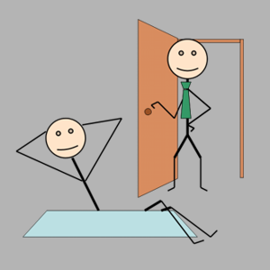
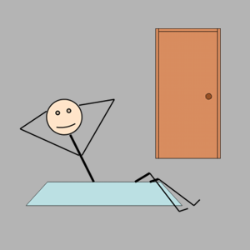
If you (the Employee) decide to work, and…
the Employer (Player 2)
inspects
the Employer (Player 2)
does not inspect
If you (the Employee) decide not to work, and…
the Employer (Player 2)
inspects
the Employer (Player 2)
does not inspect
The Employee wins: 50 points
The Employer wins: 0 points
The Employee wins: 0 points
The Employer wins: 100 points
The Employee wins: 0 points
The Employer wins: 25 points
The Employee wins: 50 points
The Employer wins: 0 points

Slide 8
As the Employee, you may have noticed that it’s best for you to work when the Employer (Player 2) inspects, and for you not to work ('shirk') when the Employer (Player 2) does not inspect.
In both of these cases you will win 50 points.
However, if you are not working and Player 2 catches you, they will win 25 points. If you are working and Player 2 doesn’t check in on you, they will win 100 points.
In both of these cases, you will not win any points.
To win the highest number of points, you must try to guess what Player 2’s next action will be.

Slide 9
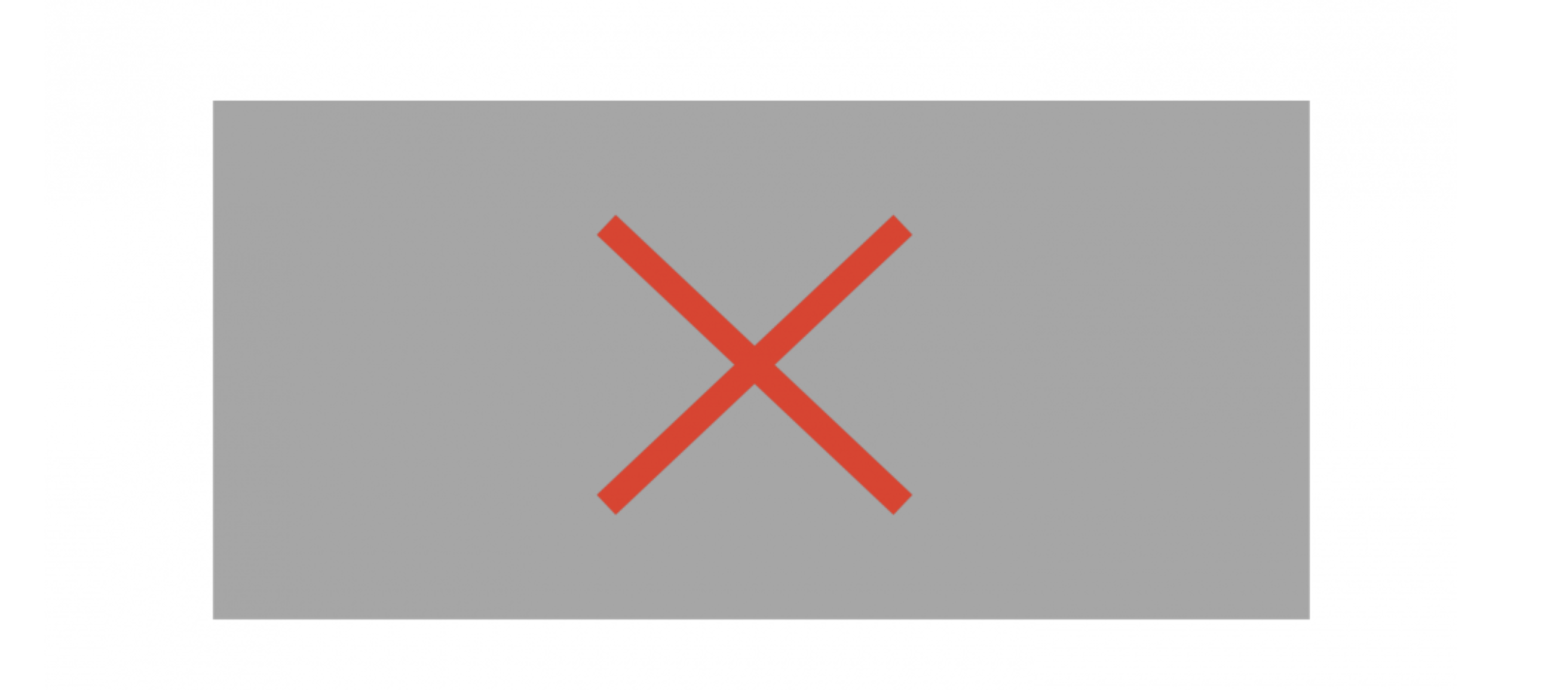
Note: if neither you nor Player 2 makes a decision on time, a red cross will appear.
The next round will begin automatically.

Slide 10
To recap:
You will be the EMPLOYEE. Your choices will be to WORK or NOT WORK (SHIRK).
Player 2 will be the EMPLOYER. Their choices will be to INSPECT or NOT INSPECT you.
All points you earn will be converted into bonus money we will give you at the end of the session.
There will be a short break halfway through the game.

Slide 11
Let's briefly check that everything is clear.

Slide 12
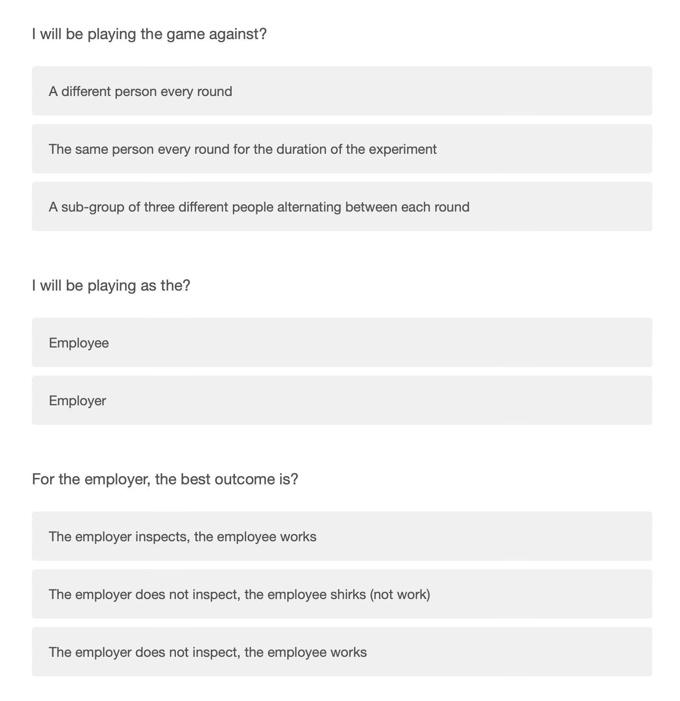

Slide 13
